Slide 1

Health map

Slide 2
In this project, we present an idea to help every expatriate and anyone who had to move to a new place that he does not know , where we make it easier for him to know all the places of medical services, such as clinics, hospitals, etc., and we also make it easier for him to know the prices of booking clinics appointment and doctors’ specialties, so that he is ready for any health problem he faces and knows where to go.

Slide 3

Project Charter
A project charter is similar to the goal, but more official, more detailed, and in line with your company’s vision and goals. project charter formalizes the goal and serves as a map to the destination. Above all, however, a project charter formally authorizes the project.

Slide 4
Project name : Health map.
Project sponsor : Ministry of Health, Ministry of communications .
Project manager : Ardina Asad.
Project team : Arwa Sayed Ibrahim, Arwa Mohamed Hamdy, Esraa Ahmed Abd Alghafoor.
project purpose :
make it easy for the people to find the places of the medical help Whether if it is a hospital ,clinic, or pharmacy , specify the Doctor's specialty and the cost of a ticket and determining the distance between the patient and the health care place and the time of arrival.
Business Case :
We are programing this app to help people who arrives to a new town or country and doesn’t know where is the places of the medical help.

Slide 5
Project Results :
health service location.
book an appointment at a clinic and knew the cost of booking.
knew information about doctors like specialty.
Basic milestone timeline :
October : start collecting the required data and build a database.
January : writing the app code and connect the code to the database.
April : test the app.
July : Proof the intellectual property of the program and lunch it.
October : collect feed backs from users and make updates.

Slide 6
Project Resources :
Budget: $50,000.
Test lab reserved for two-month.
Server.
Project Constraints, Assumptions, and Risks:
The project must be completed by April 15.
The project must not exceed $70,000.
Our preferred vendors should be able to deliver our new workstations and servers on time without affecting the project schedule.
The project must include periodic updates.
The project must include a bake up version from the database in case of any damage.
The project must include multiple language .

Slide 7

Scope
project scope statement. This document defines all of the deliverables the project will create, the boundaries of the project, and the work that the project team will need to complete in order to create the project deliverables. This document is based on the project requirements, the feasibility study, the business goals and objectives, and the business case document.

Slide 8
Scope Description:
A non-profit charitable application.
it is easily used by all age groups.
once the access to the app is done you will automatically get the places where you can get the medical help.
It’s safe to use & won’t leak information about your location.

Slide 9
Acceptance Criteria:
The user interface is easy to use.
The outputs of the application should be retrieved so fast to the user.
The output information must be very accurate and matching the truth.
The application should be light and doesn't take a large amount of space.
Deliverables:
health service location
book an appointment at a clinic and knew the cost of booking
know information about doctors like specialty

Slide 10
Exclusion:
payment by application.
Transportation to medical services locations.
the application limits are within the user's city not in the neighboring cities.
Constraints:
Budget: $50,000.
Time: 12 months.
Resources: Test lab reserved for two-month.
Assumptions:
All the doctors would approve to register to our application.
Cost accuracy

Slide 11
WBS
A WBS is a deliverables-oriented collection of project components. It is a categorization and decomposition of the project scope statement . you’re breaking down the massive project scope statement into smaller, more manageable component

Slide 12
Planning:
Create the goals
specify project requirements.
make a work plan.
2.The Cost:
make a feasibility study & budget
Buying the requirements.

Slide 13
3.Execution:
writing codes
make design and logo.
Create a property intellectual document.
4. Project launch:
Test the Project.
Launch the project.
Follow up on user feedback.

Slide 14
WBS Dictionary
dictionary is a great place to define each element of the WBS in simple-to-understand terms that all project team members and stakeholders can reference . WBS element:
■ Code of accounts number
■ Description of the WBS element
■ Person, vendor, or other organization responsible for the WBS element
■ Resources required to create the WBS element (resources are people , materials, and facilities)
■ Cost to create the WBS element
■ Quality requirements
■ Criteria for acceptance of the specific deliverable and another elements

Slide 15
Creating the goals:
Code: A11.
Description: specify our project goals and its initial ideas such as outputs of the app & why we created the app.
The responsibility of the element: Project manager, project assistant & sponsor.
Scheduled creation: 15 days.
The cost: 3000$.
criteria of acceptance: fits societal standers, useful and provide a unique serves.

Slide 16
specify requirements:
Code: A12.
Description: Requirements that will assist in the implementation of the project will be identified whether these are human, material or financial.
The responsibility of the element: Project manager, project assistant, sponsor, finance team and legal affairs.
Scheduled creation: 15 days.
The cost: 3000$.
criteria of acceptance: good quality equipment suitable for the project and affordable.

Slide 17
Work plan:
Code: A13.
Description: An action plan is created that saves time, identifies tasks, and the time needed to perform tasks.
The responsibility of the element: Project Manager, Manager assistants, Sponsor & marketing team.
Scheduled creation: 15 days.
The cost: 3000$.
criteria of acceptance: Plan identifies the task to the right person, saves time, effort, and the same time that delivers the project on schedule.

Slide 18
feasibility study & budget:
Code: A14.
Description: budget is important to the realization of the project, The budget required to achieve the project and will be determined based on the requirements and the capital available.
The responsibility of the element: Project Manager, Manager assistants, Sponsor& finance team.
Scheduled creation: 15 days.
The cost: 3000$.
criteria of acceptance: It must be adequate to meet requirements and not prohibitive or substandard on the ground.

Slide 19
buying requirements:
Code: A15.
Description: In this phase the necessary equipment to complete the work will be assembled based on the project requirements and budget available.
The responsibility of the element: Project manager, sponsor, finance team and marketing team.
Scheduled creation: 1 month.
The cost: 15000$.
criteria of acceptance: Budget should be sufficient to collect requirements without requiring funds for increases or decreases in requirements.

Slide 20
Writing codes:
Code: B1.
Description: Programmers write the code lines needed to produce an application that achieves agreed goals.
The responsibility of the element: App developers, Network Engineer and ZenWorks Expert.
Scheduled creation: 4 months.
Resources: computer lab and high quality server.
The cost: 10000$.
criteria of acceptance: Codes must be written that produce an application that achieves the desired objectives in high quality.

Slide 21
make design and logo:
Code: C1.
Description: In this phase, the user interface and trademark of the application are designed to be unique and easy to access and handle.
The responsibility of the element: Marketing Team, Project Manager& sponsor.
Scheduled creation: 1 month.
The cost: 3000$.
criteria of acceptance: You must design a distinctive, unduplicated brand and configure a smooth, easy - to - work user interface

Slide 22
property intellectual document:
Code: D1.
Description: We prove ownership of the app and its code to prevent unwanted events such as theft.
The responsibility of the element: project Manager, Sponsor & Legal affairs.
Scheduled creation: 1 month.
The cost: 3000$.

Slide 23
Test the Project:
Code: E1.
Description: In this step, we test the app by doing it more than once to prove that it is working and doing what it should.
The responsibility of the element: Project Testers.
Scheduled creation: 2 months.
The cost: 3000$.
criteria of acceptance: During software testing, the forecast should be delivered correctly and in high quality.

Slide 24
Launching:
Code: F1.
Description: The software is released on different websites and online platforms.
The responsibility of the element: Project Manager, Sponsor and Marketing Team.
Scheduled creation: 1 month.
The cost: 4000$.
criteria of acceptance: In order for this phase to be successful, we need to launch the software on the most popular online platforms and actively advertise the software in order to make all users aware of the software.

Slide 25
Responsibilities Matrix
responsibilities matrix is a method to identify all of the roles within a project and the associated responsibilities to the project work . Responsibilities matrix can help the project manager identify the needed resources to complete the project work and determine if the resources exist within the organization’s resource pool.

Slide 26
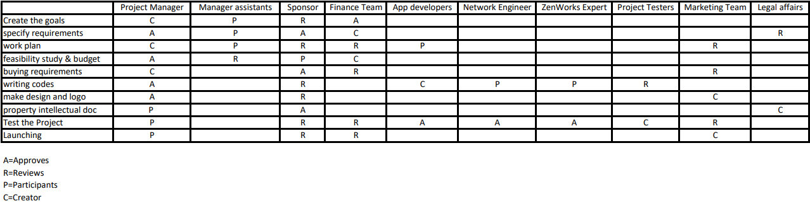

Slide 27
Project network:
Project networks are developed from the WBS. The project network is a visual flow diagram of the sequence, interrelationships, and dependencies of all the activities that must be accomplished to complete the project.

Slide 28
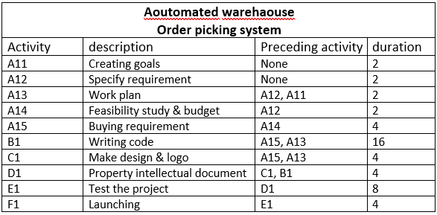

Slide 29
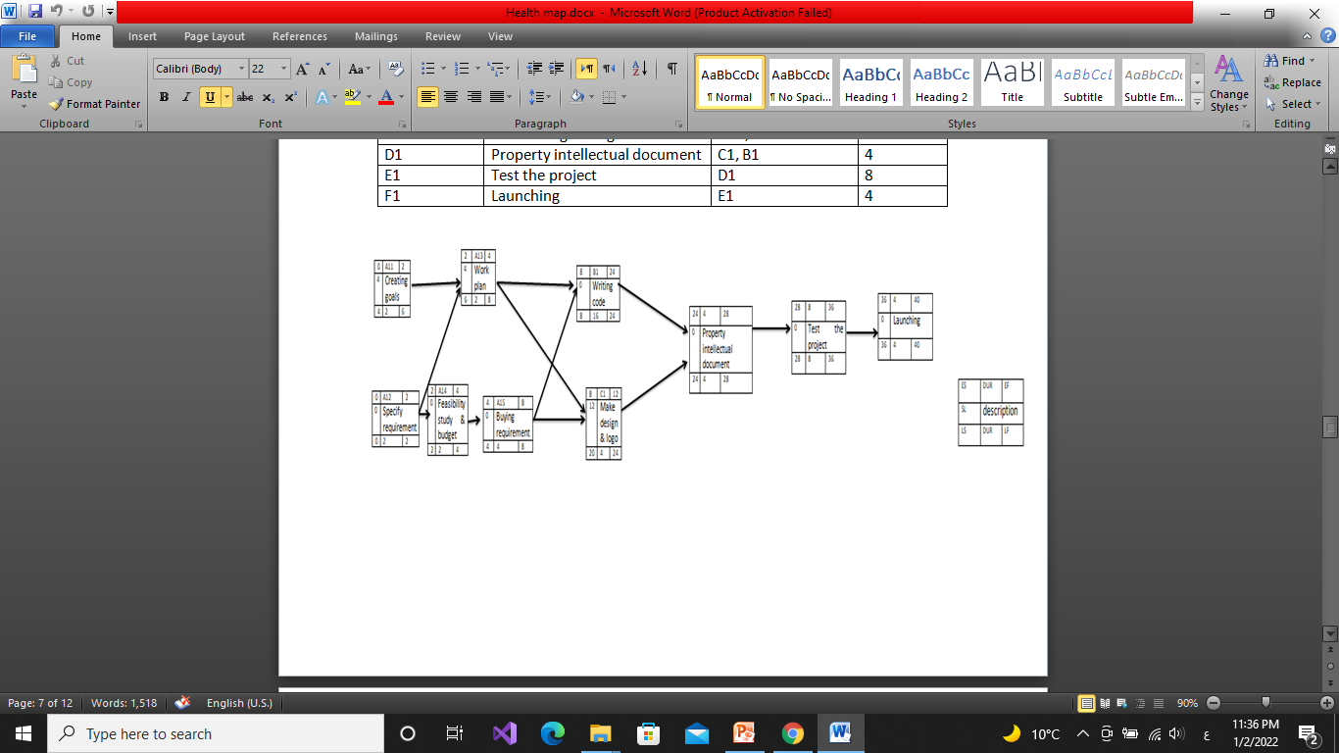

Slide 30
RESOURCE CONSTRAINED:
resource-constrained project is one that assumes the level of resources available cannot be exceeded. If the resources are inadequate, it will be acceptable to delay the project, but as little as possible.

Slide 31
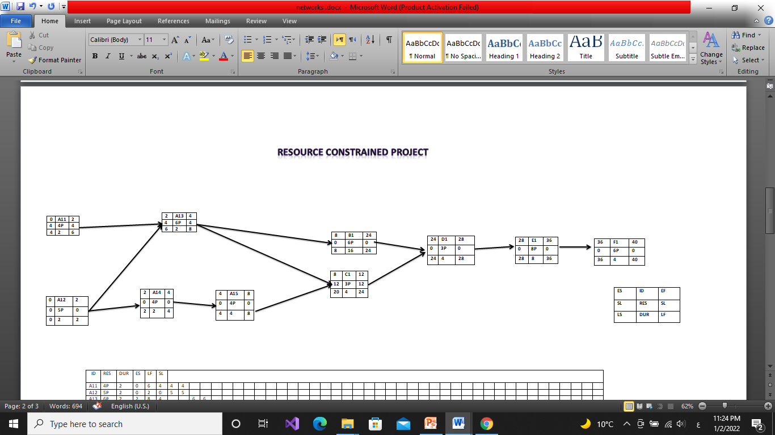

Slide 32
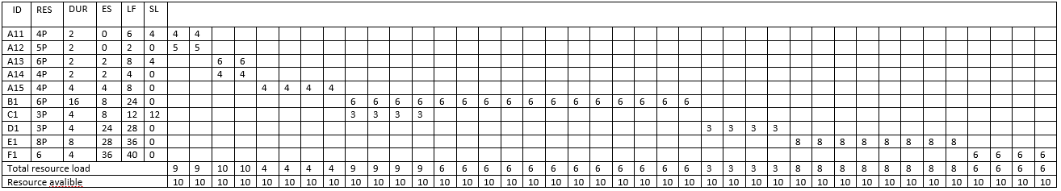

Slide 33
TIME-PHASED BUDGET BASELINE:
you can time-phase work packages and assign them to their respective scheduled activities to develop a budget schedule over the life of your project.

Slide 34
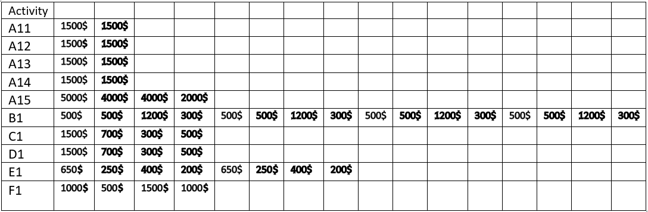
•Matrix of Activity with weekly cost:

Slide 35
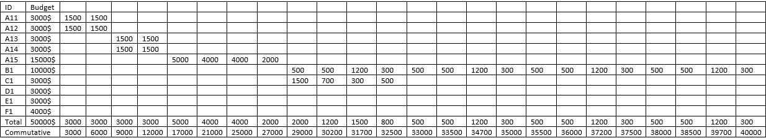
Baseline Budget:

Slide 36
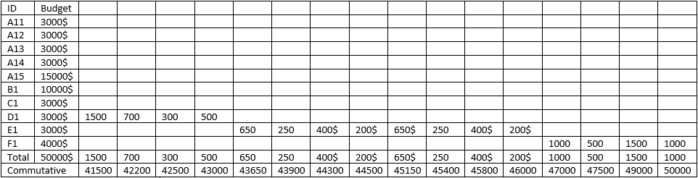
Baseline Budget:

Slide 37
Risk Management:
The risk management plan is a component of your overall project management plan that details how project risks will be identified, analyzed, responded to, and controlled. Risk management happens throughout the project, and you and the project team should always be on the lookout for new risk events.

Slide 38
Risk 1 Create the goals:
The goals and ideas may be already existed.
To avoid this danger, we will resort to assistants to search and check This leads to a delay in the time period.
This risk will result in one to two days of delayed rendition.
Risk 2 specify requirements:
Inability to specify requirements accurately.
The technology would change and the specified requirements would be outdated.
To avoid this danger, we could consult the network team in determining the technological requirements and making extensive research.

Slide 39
Risk 3 making work plan:
Circumstances that make those responsible for certain tasks unable to perform these tasks, such as illness and death.
To avoid this danger, we can make a pack up work plan or ask the Manager assistants to hire more than one person for a single task.
If this risk occurs, it will lead to a delay in the implementation of tasks and an increase in the budget due to the use of new people to finish this task.
Risk 4 feasibility study & budget:
The budget is not available at the time of project or it is not enough.
To avoid this danger, the sponsor and feasibility team have to make sure that the budget is accurate and available before starting the project.
If this risk occurs, this may lead to a delay in the implementation of the project and may lead to Failure to implement the project.

Slide 40
Risk 5 buying requirements:
The required requirements do not exist locally and we will have to import them or it costs more than expected.
To avoid this danger, the project management & project assistant have to search well in all local markets to purchase these requirements or choose the nearest foreign markets so that the project schedule is not affected and choosing the requirements that serve the purpose and fit the budget
If this risk occurs, It may lead to delay the project schedule until the requirements are available and the budget is affected to purchase the required requirements.
Risk 6 Writing codes & testing the app:
Errors occur while writing the code or the code does not serve the project's purpose correctly.
To avoid this danger, the HR should make sure to choose good programmers.
If this risk occurs, this may lead to a delay in the delivery of the code and an increase in cost due to the use of efficient programmers.

Slide 41
Risk 7 make design and logo:
Logo is similar to another application’s Logo or is not expressive, and the user interface may not be easy to use and complex.
To avoid this danger, the marketing team & App developers should choose a unique logo and design smooth user interface.
If this risk occurs, this leads to users not using the application and it will affect the work schedule until ensuring the integrity of the logo and interface.
Risk 8 property intellectual document:
Stealing the project idea.
To avoid this danger, the legal affairs should speed the completion of the process to protect the project from theft.
If this risk occurs, this leads to the failure of the whole project.

